Slide 1

Gestalt Principle in Auditory Perception
Yuhe Qin 2024.11.14

Slide 2
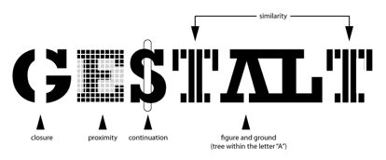
Introduction
Gestalt theory, widely employed in cognitive psychology, explains fundamental principles of visual perception.
In recent years, these principles have also been extensively applied to auditory perception.
Inspired by a Gestalt computational model in visual perception*, we aim to identify regular patterns in auditory perception and develop a corresponding computational model.
*Jiayu Zhou et al., The gestalt computational model, arXiv preprint arXiv:2405.20583v1 (2024).

Slide 3
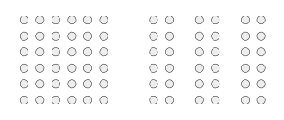
Gestalt Principle in Visual Perception
Proximity

Slide 4
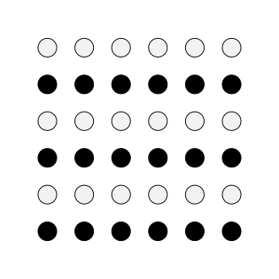
Gestalt Principle in Visual Perception
Similarity

Slide 5

Gestalt Principle in Visual Perception
Closure

Slide 6


Gestalt Principle in Visual Perception
Good Continuation

Slide 7
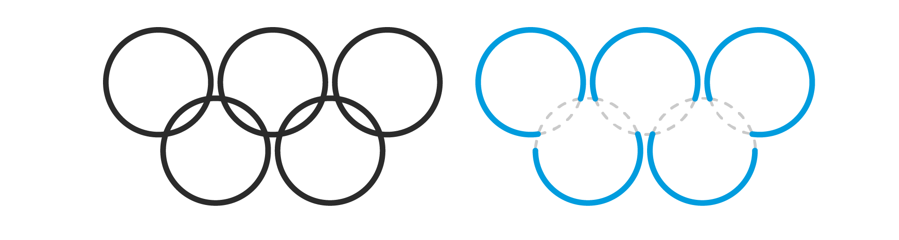
Gestalt Principle in Visual Perception
Simplicity

Slide 8

Gestalt Principle in Visual Perception
Common Fate

Slide 9

Gestalt Principle in Visual Perception
Rhythmic Law

Slide 10
Gestalt Principle in Auditory Perception
Factors Affecting Auditory Streaming
Frequency (also pitch)
Timbre: Analogy to color in vision
Amplitude
Onsets and offsets: Sudden changes in the intensity of the time signal
Spatial cues:
Interaural level differences (ILDs)
Interaural time differences (ITDs)
Temporal modulation: Similar frequencies or rhythmic patterns

Slide 11
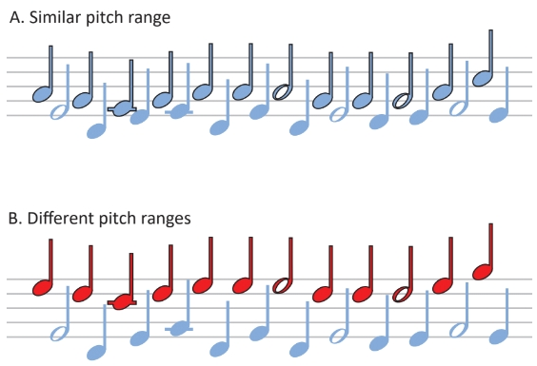
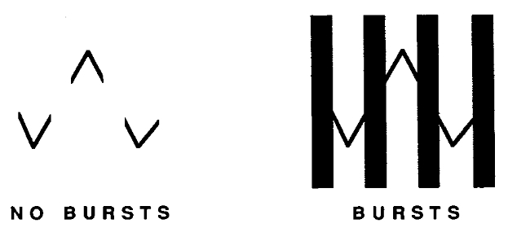
Gestalt Principle in Auditory Perception
Examples
Similarity in Pitch Range
Good Continuation

Slide 12
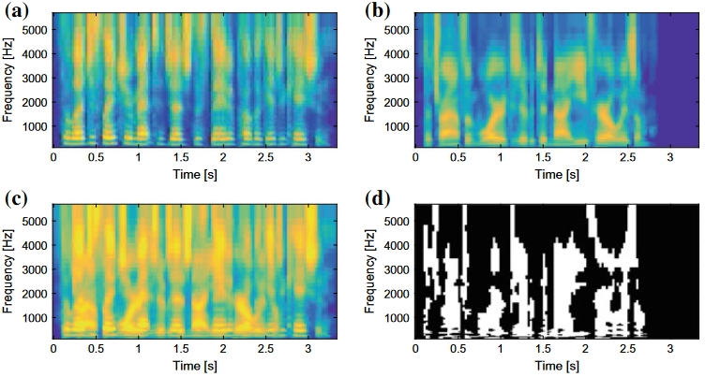

The Gestalt Computational Model in Auditory Perception
Research Plan
Step1. Extract $n$ features related to the auditory stream formation and perform time-delay embedding on each, embedding them into an $m$-dimensional space. These embeddings will then be combined to form a $nm$-dimension space.
Step2. Compute the persistence diagram (PD) in this $nm$-dimensional space.
Maybe by MFCC?
Consider more ways to solve longer sequences…(maybe not by TDE)
An idea: Maybe we can cut the long sequences into small sequences with gaps (like 50%)? Then apply TDE on the small sequence.

Slide 13
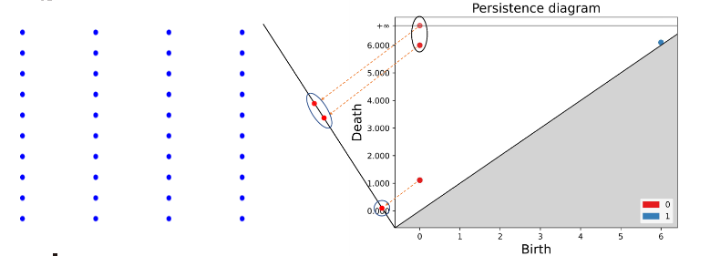
The Gestalt Computational Model in Auditory Perception
Research Plan
Step3. The points in the PD are projected onto the line y = −x, and the projected points are clustered into two groups using a clustering method, such as the k-means algorithm (with k = 2).
The group closer to the origin (0, 0) represents noise points, referred to as the “noise class”, while the group farther from the origin represents significant points with greater persistence, referred to as the “significant class”.

Slide 14
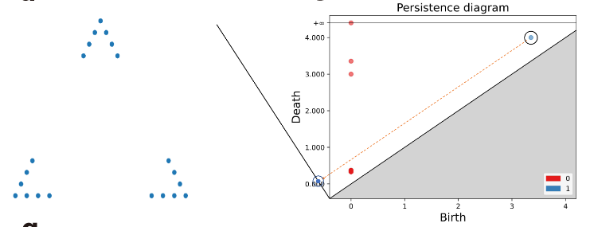
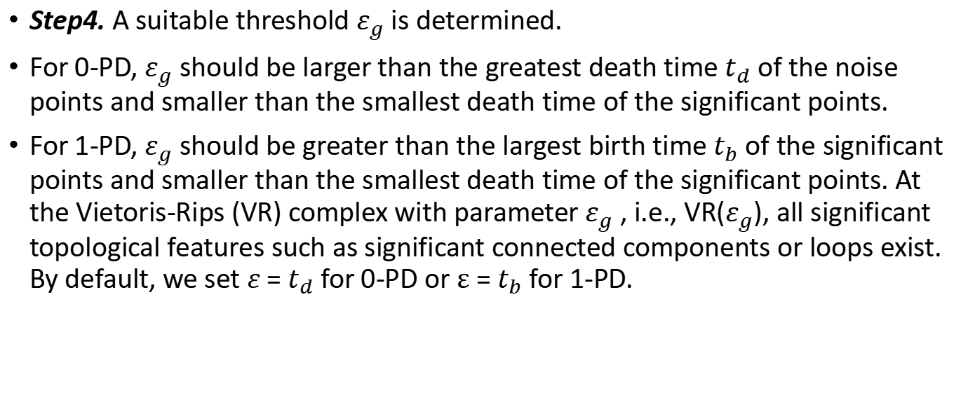
The Gestalt Computational Model in Auditory Perception
Research Plan
Step4. A suitable threshold $ε_{g}$ is determined.
For 0-PD, $ε_{g}$ should be larger than the greatest death time $t_{d}$ of the noise points and smaller than the smallest death time of the significant points.
For 1-PD, $ε_{g}$ should be greater than the largest birth time $t_{b}$ of the significant points and smaller than the smallest death time of the significant points. At the Vietoris-Rips (VR) complex with parameter$ε_{g}$ , i.e., VR($ε_{g}$), all significant topological features such as significant connected components or loops exist. By default, we set $ε$ = $t_{d}$ for 0-PD or $ε$ = $t_{b}$ for 1-PD.

Slide 15
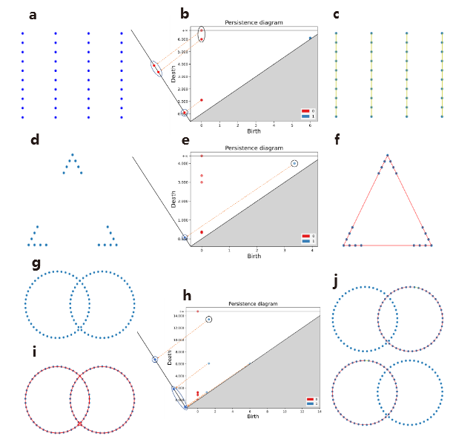
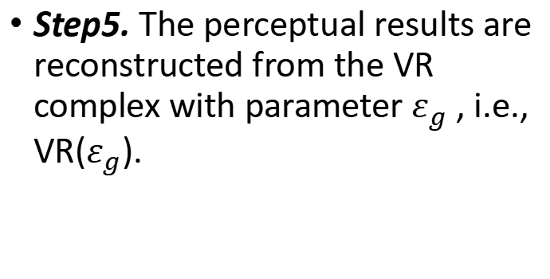
The Gestalt Computational Model in Auditory Perception
Research Plan
Step5. The perceptual results are reconstructed from the VR complex with parameter $ε_{g}$ , i.e., VR($ε_{g}$).
We use Persistent Homology to process the point cloud formed by the characteristics of the sound, and then group the point cloud through the VR complex obtained to determine the formation of the auditory stream.
(Maybe use some other knowledge for processing?

Slide 16


Restruction of the Gestalt Principle by VR Complex
Point Cluster & Threshold determination
New Page!
Project the points in a _____ onto the line y = −x, and cluster the projected points into noise class and significant class.
A. 0-PD
Similarity, Proximity
$ε_{g}$: greater than the largest death time $t_{d}$ of the noise points and less than the smallest death time of the significant points
B. 1-PD
Closure, Good Continuation, Simplicity
$ε_{g}$: greater than the largest birth time $t_{b}$ of the significant points and less than the smallest death time of the significant points

Slide 17
Future Works
Search for the mathematical expression of factors affecting auditory streaming and categorize them into those suitable for topological analysis and those that are not.
Attempt to apply time-delay embedding and form persistence diagram.
Explore potential synergies with the research conducted by Prof. Ximena Fernández* and Prof. Hongwei Lin to uncover additional possibilities.
Attempt to study the emergence from factors to principles of auditory perception.
*Reise, Wojciech, Ximena Fernández, Maria Dominguez, Heather A. Harrington, and Mariano Beguerisse-Díaz. 2023. ‘Topological Fingerprints for Audio Identification’.

Slide 18
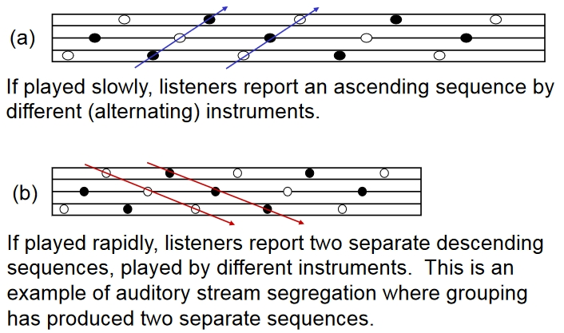
Problems
When constructing the model, I think it can be done by first building out the individual auditory streams and then assembling them together. Finally test whether our model can restore the separate auditory streams at the very beginning.
In real-world scenarios, people’s application of these principles is likely to be multifaceted, and further research is needed to understand how specific Gestalt rules are applied in practice.

Slide 19
Thank you!

